Slide 1
Faculty Senate Meeting
January 23, 2020

Slide 2
Agenda
Call to Order and Roll Call
K. Homan, Secretary

Slide 3
Agenda
Approval of Minutes
January 23, 2020

Slide 4
Agenda
III. Campus Reports
A. Staff Council, B. Spencer

Slide 5
Agenda
III. Campus Reports
B. Student Council, K. Kessinger

Slide 6
Student Council
Upcoming Events
Mental Wellness Listening Session
Toomey 199
6PM on February 27th
Electing New Student Body President
Week of March 2nd
Announced March 9th

Slide 7
Student Council
Student Leaders Awards
Form to nominate is open. It will close March 20th
Project Unify Proposal
Intercampus Student Council is writing a proposal to the Project Unify Group
Summary: ISC would like drop dates to match refund dates.
Retention Study
Major Issues:
Intuitive Systems
Visibility of other programs

Slide 8
Agenda
IV. President’s Report
S. Corns

Slide 9
Administrative Review Committee
Surveys have been sent out
Survey should be available today
Will remain open until the first week of April
Please participate in both
COACHE Survey

Slide 10
Guest Speakers
We are planning on inviting Neil Outar and Benjamin White to discuss Title IX
Working on scheduling an open forum with Matt Gunkel in March
eLearning initiative

Slide 11
Intercampus Faculty Council (IFC)
Last IFC meeting, February 10
Discussion of bad weather closures
Some discussion by President Choi about academic pluralism
Our representative is Trent Brown
Discussion with Jill wood on Open Access Publishing initiative
No changes (as of now) on Elsevier subscriptions
HR report on mandatory training modules

Slide 12
Agenda
V. Reports of Standing Committees
A. Curricula
S. Raper

Slide 13
CCC Meetings
5 February
1 April (upcoming, no fooling)
Total Committee Activity
2 Certificate programs (PC forms)
18 Degree change request (DC forms)
15 Course change requests (CC forms)
0 Experimental course requests (EC forms)

Slide 14
Certificate Programs (PC) Requested
File: 347 PROPOSED: Geophysics Graduate CT
File: 348 PROPOSED: Petroleum Systems CT

Slide 15
Degree Program Changes (DC) Requested
File: 141.31 AE ENG-BS: Aerospace Engineering BS
File: 143.35 ARC ENG-BS: Architectural Engineering BS
File: 150.77 CH ENG-BS: Chemical Engineering BS
File: 151.12 CHEM-BA: Chemistry BA
File: 28.64 CMP SC-BS: Computer Science BS
File: 153.67 CP ENG-BS: Computer Engineering BS
File: 149.27 CR ENG-BS: Ceramic Engineering BS
File: 152.18 CV ENG-BS: Civil Engineering BS
File: 155.54 EL ENG-BS: Electrical Engineering BS

Slide 16
Degree Program Changes (DC) Requested (cont’d)
File: 44.33 ENG MG-BS: Engineering Management BS
File: 51.15 EV ENG-BS: Environmental Engineering BS
File: 261.4 FR ENG-UN: Foundational Engineering and Computing
File: 156.32 GE ENG-BS: Geological Engineering BS
File: 86.43 MC ENG-BS: Mechanical Engineering BS
File: 95.28 MI ENG-BS: Mining Engineering BS
File: 90.30 MT ENG-BS: Metallurgical Engineering BS
File: 104.16 NU ENG-BS: Nuclear Engineering BS
File: 108.41 PE ENG-BS: Petroleum Engineering BS

Slide 17
Course Changes (CC) Requested
File: 1090.1 BIO SCI 4383: Toxicology
File: 2394.1 BIO SCI 6383: Advanced Toxicology
File: 1117.1 CHEM 1110: Orientation for Chemistry Majors
File: 2593.1 CHEM 1301: Introductory Chemistry
File: 1321.1 CHEM ENG 5100: Intermediate Transport Phenomena
File: 1782.1 CHEM ENG 5120: Interfacial Phenomena In Chemical Engineering
File: 1419.1 CHEM ENG 5170: Physical Property Estimation
File: 4292.8 CHEM ENG 5241: Intermediate Process Safety in the Chemical and Biochemical Industries

Slide 18
Course Changes (CC) Requested
File: 1012.1 CHEM ENG 5310: Structure and Properties of Polymers
File: 1693.1 CHEM ENG 5330: Alternative Fuels
File: 1731.1 CHEM ENG 5340: Principles of Environmental Monitoring
File: 106.1 CHEM ENG 5350: Environmental Chemodynamics
File: 2393.1 CHEM ENG 6241: Intermediate Chemical Process Safety
File: 1868.1 FR ENG 1100: Study And Careers In Engineering and Computing
File: 931.1 MECH ENG 4480: Control System Laboratory

Slide 19
Curriculum committee moves for FS to approve the DC and CC form actions
Discussion: Questions or comments?

Slide 20
For Informational Purposes; No Senate Approval Required
Experimental Course (EC) Requests

Slide 21
Agenda
V. Reports of Standing Committees
B. Rules, Procedure, and Agenda
S. Sedigh Sarvestani

Slide 22
Rules, Procedures, and Agenda Committee
Dr. Sahra Sedigh Sarvestani, Chair
Election for faculty representatives to Conflict of Interest committee
Vice Chancellor Tsatsoulis has requested that three faculty representatives be added to the committee, bringing the total to six.

Slide 23
Charge to Conflict of Interest Committee
The Chancellor has charged the Conflict of Interest Committee (COIC) with the responsibility for management of all conflicts of interest at the Missouri University of Science and Technology, pursuant to CRR 330.015, 420.030, and 410.020.
Conflicts are common and unavoidable in a modern research university. The COIC works to assist faculty and staff to structure appropriately their various interests to avoid, mitigate, or manage those conflicts.
No two situations are the same; therefore, the Committee works diligently to understand each scenario to find custom solutions that best meet the needs of the parties involved.

Slide 24
Composition of Conflict of Interest Committee
The COIC will consist of five members, as follows:
Chair (three-year term): Senior level administrator, appointed by Chancellor or designee. The Chair will also serve as the Missouri S&T COI Officer.
Three tenured faculty members appointed by Faculty Senate (staggered three-year terms)
One Division of Administrative Services representative (three-year term), appointed by Chancellor or designee.

Slide 25
Members for AY 2019-2020
Name | Affiliation | Representing (selected by) | Term (July)
Tsatsoulis, Costas - CHAIR | Sponsored Programs | Chancellor | 2022
Massri, Anas | Finance and Operations | Chancellor | 2022
Northcut, Kathryn | English & Technical Communication | Faculty Senate | 2020
ElGawady, Mohamed | Civil, Architectual, and Enviromental Engr. | Faculty Senate | 2022
Park, Eun Soo | Economics | Faculty Senate | 2020
Non-Voting, Ex-Officio
Van Zandt, Mark | UM General Counsel Office | UM General Counsel Office Rep. | N/A
Strassner, Keith | Technology Transfer Office Director | Chancellor | N/A
Hines, Jonathan | Development Officer | Chancellor | N/A
Towns, Karen | Sponsored Programs Compliance Officer | Chancellor | N/A
Westenberg, David | Biological Sciences | Institutional Review Board | N/A

Slide 26
Nominees (listed alphabetically)
Vote for only three of the four nominees below.
Cassie Elrod, Business and Information Technology
Matt Insall, Mathematics and Statistics
Jonathan Kimball, Electrical and Computer Engineering
Jianmin Wang, Civil, Architectural, and Environmental Engineering

Slide 27
Agenda
V. Reports of Standing Committees
C. Effective Teaching
D. Oerther

Slide 28
Update on Activities of the Committee on Effective Teaching
Dan Oerther, Chair, CET
20 February 2020
Faculty Senate

Slide 29
NEW definition of effective teaching
The CET defines effective teaching at Missouri S&T as locally optimized instruction – sensitive to students, leveraging faculty expertise, and supported by institutional resources – which achieves measured improvements in the knowledge, skills, and attitudes of students.

Slide 30
Current baseline of effective teaching
The current baseline of measurements of effective teaching at Missouri S&T includes historical scores of end-of-semester questionnaires administered in an anonymous, online format.
Although a minimum of 11 common questions is included in every assessment, Departments and the campus use the result from a single question to document “effective teaching”. This score is known as the “CET Score”, and it is reported as the mean result of student response to the question, “Rate the overall teaching effectiveness of this instructor.”
A Likert-scale is used with a range from 0 (Poor/Strongly Disagree) to 4 (Excellent/Strongly Agree).
Scores below “2.0” are generally considered “concerning”, while scores in the range of “3.5” are generally considered worthy of “recognition”.

Slide 31
Plan to improve effective teaching – item 1 of 3
The current end-of-semester instrument, delivered in an online format, and completed anonymously by students outside of class time must be substantially modified as follows:
The instrument should be updated with new campus-wide questions to objectively assess the four attributes of effective teaching, including:
1) up-to-date content;
2) an intentional approach to pedagogy;
3) clarity of assignments, schedule, due dates, and grading criteria; and
4) outcomes-based instruction
The new instrument should be deployed twice – at mid-semester and at the end-of-semester – providing an opportunity for real-time improvement of teaching during the semester as well as long-term measurement of instructor performance
The new instrument should continue to be delivered in an online format, continue to be completed anonymously, but be scheduled to be completed during class time – when the instructor leaves the room – to increase student participation
Students should participate in and be informed of these changes to achieve buy-in and active participation by students in measurement of effective teaching (i.e., students must know that their input is valued and that improvements in teaching will be adopted based upon student input)

Slide 32
Plan to improve effective teaching – item 2 of 3
To assess effective teaching using multiple measurement instruments, all Departments should be encouraged to adopt one or more of the peer observation instruments listed in the 2018 Intercampus Faculty Council report (or an equivalent).
This Department action should be incentivized by excluding faculty who have not received an annual peer teaching effectiveness observations from participating in faculty teaching recognition programs at Missouri S&T (i.e., at a minimum for faculty teaching awards).

Slide 33
Plan to improve effective teaching – item 3 of 3
To provide a clear signal of appropriate institutional support for effective teaching, the current three-legged stool of faculty workload – research, teaching, and service – should be clarified as – scholarship, instruction, and service.
The investment of scholarly efforts at improving teaching and learning (i.e., scholarship of teaching and learning) must be recognized as valuable in decisions of appointment, reappointment, tenure, and promotion (i.e., as research).
The rigor of external, (inter)national peer reviewed is a hallmark of traditional discovery scholarship (i.e., securing a competitive NSF grant and authoring a peer-reviewed article in the archival literature), and should be the pursuit of faculty who conduct research in the scholarship of teaching and learning.
To further the goals of better teaching, the investment of institutional support of traditional discovery research (i.e., course-load reduction and proportionately larger share of the annual raise pool) also should be the reward provided to the rigorous pursuit of teaching excellence.

Slide 34
How will improvement be achieved?
Via actions of CET in partnership with CAFE and other stakeholders including Provost/Deans/Department Chairs as well as faculty, staff, and students

Slide 35
How will improvements be documented?
Year over year reports of CET scores

Slide 36
Agenda
V. Reports of Standing Committees
D. Information Technology/Computing
J. Singler
-No Report

Slide 37
Agenda
V. Reports of Standing Committees
E. Tenure
G. Cohen

Slide 38
ISSUE #2
A year or so ago the S&T Faculty Senate approved the reduction of the number of appeals by a candidate from six to three, and the P&T regulations document was then duly altered to reflect that change. But an oversight occurred; the changes were made in one part of the document, but the last page still mentioned various appeals totaling six. That of course had to be corrected.
Associate Provost Daniel Forciniti contacted me about this issue, and although we discussed only the last page, he then noticed a few spots earlier in the document that required a slight revision. The document with the changes that needed correcting was shared with the Tenure Policy Committee, after which a vote was taken (yes, no, abstain). Sixteen of the eighteen committee members voted, and the tally was:
YES: 16
NO: 0
ABSTAIN: 0
The overwhelming yes vote was due to all the recommended changes being
non-controversial.

Slide 39
TENURE POLICY COMMITTEE, ISSUE OF REDEFINING SCHOLARSHIP
BASED ON PLAN OF WORCESTER POLYTECHNIC INSTITUTE
Report by Jerry Cohen
December 16, 2019
The Tenure Policy Committee recently voted on the following motion:
“Should our campus broaden the definition of scholarship according to the plan instituted by Worcester Polytechnic Institute?”
Seventeen of the 19 committee members have voted, and the tally is:
YES: 0
NO: 17
ABSTAIN: 0
Here now is background to that development.

Slide 40
PROVOST’S REQUEST TO THE COMMITTEE
On Nov. 21, 2019 Provost Stephen Roberts requested the Tenure Policy Committee to consider the suggestions in a May 2019 article about Worcester Polytechnic Institute and its new policy on promotion to full professor; of particular interest is WPI’s broadening of what is considered scholarship:
“Dear Tenure Policy Committee
Below is a CHE article about some recent changes in the promotion standards at WPI. Is it possible that our faculty might be inclined to consider a similar, more holistic interpretation of scholarship that would create a wider (but just as steep) pathway to promotion? I’ve shared the link and posed the same question to the Faculty Senate officers, as well as the CAFÉ steering committee. I am not advocating for any particular outcome, but hoping that our colleagues might be willing to have a conversation about widening the path to promotion by a broader vision of the forms of scholarship.
Steve”

Slide 41
TWO SEPARATE ISSUES
The beginning of the WPI article says:
“About one-third of associate professors at research institutions are unclear about their departments’ performance standards for promotion to full
-2-
professor. The same share are unclear about promotion criteria and timelines -- when should they apply?
“One-third of these associate professors are unclear as to whether or not they’ll be promoted. And one-quarter haven’t received feedback as to their progress toward full professor one way or another.”
We deal here with two separate issues:
The need to clarify what the standards of promotion are and what progress each faculty is making toward that goal. This should not be difficult. Each department has already prepared guidelines for tenure and promotion, and clarification should be part of the annual review. As part of that review, the chair could, if necessary, seek advice from the department’s p&t committee.
The need to consider whether the campus’ guidelines of what is acceptable/persuasive scholarship for promotion should be broadened.
This is the issue of importance for our committee now.

Slide 42
WPI ARTICLE: “MULTIPLE SCHOLARSHIPS”
Under the heading “Multiple Scholarships” the WPI article writes:
“So faculty members at the institute got to work to defog the promotion process and, in so doing, improve it. In the end, they decided it was all about scholarship -- defined five different ways. This is not just a synonym for traditional research. Each definition is a criterion for promotion to full professor, and professors who excel in some areas but not in others already have succeeded.
▪ Scholarship of discovery -- creation of new knowledge, demonstrated in publications and presentations
▪ Scholarship of integration -- interpretation and analysis of existing knowledge
▪ Scholarship of application and practice -- application of knowledge to address important individual, institutional and societal problems
▪ Scholarship of teaching and learning -- development and improvement of pedagogical practices that are shared with others
▪ Scholarship of engagement -- collaborative partnerships with communities for the mutually beneficial exchange of knowledge and resources.”

Slide 43
A LOOK AT UM’S COLLECTED RULES AND REGULATIONS
The above categories clearly all have value but do they also qualify as what is generally regarded as research/scholarship? Note the following in the CRR:
https://www.umsystem.edu/ums/rules/collected_rules/personnel/ch320/320.035_policy_and_procedures_for_promotion_and_tenure
Policy and Procedures for Promotion and Tenure. B.2.d. and f.
The Role of Service—Opportunities for service contributions abound and can take many forms. Service may occur within a discipline, through national, regional, and state organizations, or in the community at large; it may also occur in an administrative unit, such as the home department, school, or college, or on the campus. However, an uncritical list of such activities provides little support for the recommendations. A case should be made for the impact and quality of the individual’s contributions. There should be evidence that the individual’s efforts and judgment are held in high regard. Evidence of unusual service contributions, however, cannot by itself be sufficient grounds for a recommendation for promotion and/or tenure. It must be supported by significant additional evidence of contributions in teaching and research.
Promotion to Professor—A person recommended for promotion to the rank of professor should have significant accomplishments, especially in the area of research and scholarly activity, beyond those justifying the rank of associate professor. Years of service alone do not justify advancement. Rather, sustained contributions during a career to research, scholarship, and teaching are necessary. A person to be considered for promotion to professor should be a scholar who has achieved national distinction.

Slide 44
Now, WPI’s first category (Scholarship of discovery) is unambiguously acceptable, and category 2 (Scholarship of integration) is likely also acceptable. But problems seem to arise with categories 3 (Scholarship of application and practice) and 5 (Scholarship of engagement). These two categories look like service; and note CRR B.2.d:
“…Evidence of unusual service contributions, however, cannot by itself be
sufficient grounds for a recommendation for promotion and/or tenure. It must
be supported by significant additional evidence of contributions in teaching and
research.”
And B.2.f seems to be emphasizing scholarly achievement in its traditional sense, i.e., by scholarly research:
“A person recommended for promotion to the rank of professor should have
significant accomplishments, especially in the area of research and scholarly
activity…”

Slide 45
WPI ARTICLE: “MULTIPLE SCHOLARSHIPS”
Under the heading “Multiple Scholarships” the WPI article writes:
“So faculty members at the institute got to work to defog the promotion process and, in so doing, improve it. In the end, they decided it was all about scholarship -- defined five different ways. This is not just a synonym for traditional research. Each definition is a criterion for promotion to full professor, and professors who excel in some areas but not in others already have succeeded.
▪ Scholarship of discovery -- creation of new knowledge, demonstrated in publications and presentations
▪ Scholarship of integration -- interpretation and analysis of existing knowledge
▪ Scholarship of application and practice -- application of knowledge to address important individual, institutional and societal problems
▪ Scholarship of teaching and learning -- development and improvement of pedagogical practices that are shared with others
▪ Scholarship of engagement -- collaborative partnerships with communities for the mutually beneficial exchange of knowledge and resources.”

Slide 46
And B.2.f seems to be emphasizing scholarly achievement in its traditional sense, i.e., by scholarly research:
“A person recommended for promotion to the rank of professor should have
significant accomplishments, especially in the area of research and scholarly
activity…”
ADDITIONAL THOUGHTS
Suppose the campus officially regards the final three WPI categories as scholarship acceptable for promotion to professor, Won’t all departments be required to accept them, even if some departments wish to maintain traditional standards? And would this not weaken the achievements that result from those traditional standards?
And if those three categories are acceptable for promotion to full professor, i.e. if they represent bona fide scholarship rather than service (however valuable), why should those three categories not also be acceptable for tenure and promotion to associate professor?
Has the WPI policy been implemented anywhere else? It seems quite recent, and there is no need to consider adopting it for S&T at least until we see the results elsewhere.
What will happen when letters to outside evaluators go out in promotion-to- full-professor cases? Suppose their institutions aren’t on board with the new policy of what constitutes scholarship and some (many?) evaluators write that they consider the scholarship of Candidate X to be insufficient. This is
a major concern, underscored by one of the committee’s senior faculty members:
“…the mid-career stagnation/confusion of associate professors is an issue… Departments and department chairs should outline in the clearest possible terms the expectations for promotion, as should any potential mentors. If the expectations are not clear to faculty members, then our committee and administration should strongly encourage all interested parties--chair, department etc.--to make them so. …
Also, in the last few years, our campus established the CAFE program for just this sort of purpose. I'm inclined to see how our substantial monetary and personnel investment in this program plays out, before we consider implementing wholesale WPI style changes.”

Slide 47
I would add just a brief note of caution to the above excellent recommendation on advising associate professors: The Chancellor has the final decision on all tenure and promotion cases, so no advice should contain a promise that if a candidate does such-and-such he/she is guaranteed a favorable outcome. That
-5-
outcome may be likely but should not be described as guaranteed. No chancellor would agree to relinquishing his/her authority to have the final say.

Slide 48
Agenda
V. Reports of Standing Committees
F. Budgetary Affairs M. Fitch

Slide 49
Budgetary Affairs Committee
Nov 21, 2019
New Item:
Provost invitation to generate academic funding model
Active referrals:
Cost of waivers for graduate students
Continuing:
Report on the “big picture balance sheet”
Current and next FY budget
Kauffman/5yr

Slide 50
Budget: no changes from September report
Operations budget, current fiscal year (FY)
Revenue = $150.8 MM, Expenditures = $147.5 MM
Next FY revenue projection
Student count remains down by 248 $-2.8MM
Next FY cost expectations
2% raise pool $2 MM
Benefit cost increases 1.2 MM
P&T, NTT promotion, PTR awards 0.235 MM
Minimum wage increase 0.3 MM
Golf Team (currently cost not rate) 0.2 MM
IT, insurance, utilities, building repair 0.7 MM
Sum $7.3 MM
We can affect
Mandated by Choi
State exempted State; only for full-time employees

Slide 51
Next year:
-5%

Slide 52
Provost’s invitation (briefly mentioned last month)
Collaborative: BAC, Department Chairs, Deans, Finance
Idea: “performance-based budget incentive model for academic departments”
Friday 14 Feb meeting:
Transparency important
BAC generally positive; no rush, be thoughtful
Asked for administrative and chair’s buy-in
Concerned hours invested >> funds affected
Vast majority of costs are salaries and wage, a formula cannot set annual department budgets
Model would have to reflect diverse priorities and diverse departments

Slide 53
Cost of waivers
Next slides, last eight years (FY 2013 funding, FY 2017 implementation):
Tuition rates
Graduate student counts
Graduate appointments at or above 0.25 FTE
Gross graduate tuition, waivers, and net revenue
Observations

Slide 54
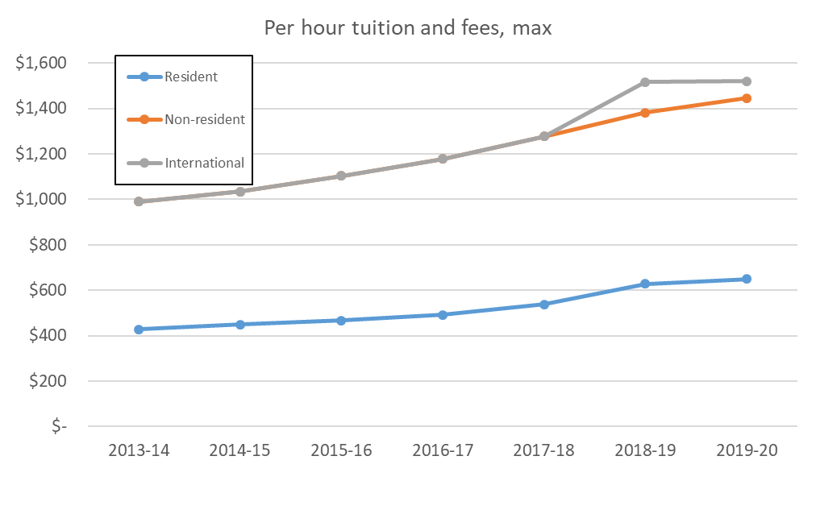
7.6% average increase
6.5% average increase
7.3% average increase

Slide 55
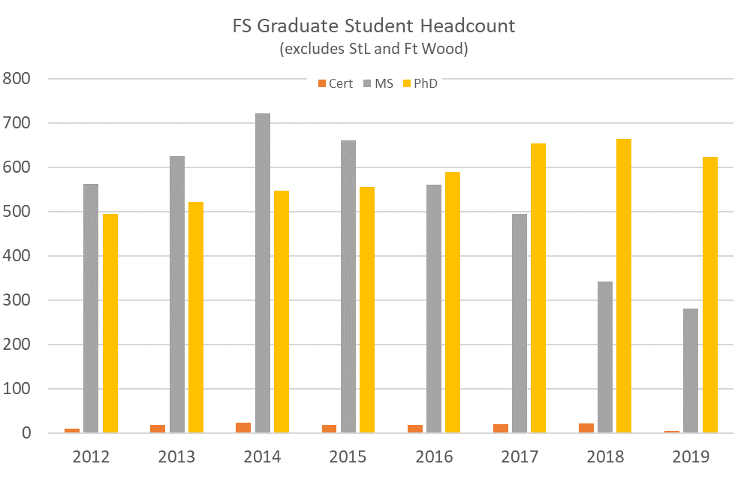
+75
-441

Slide 56
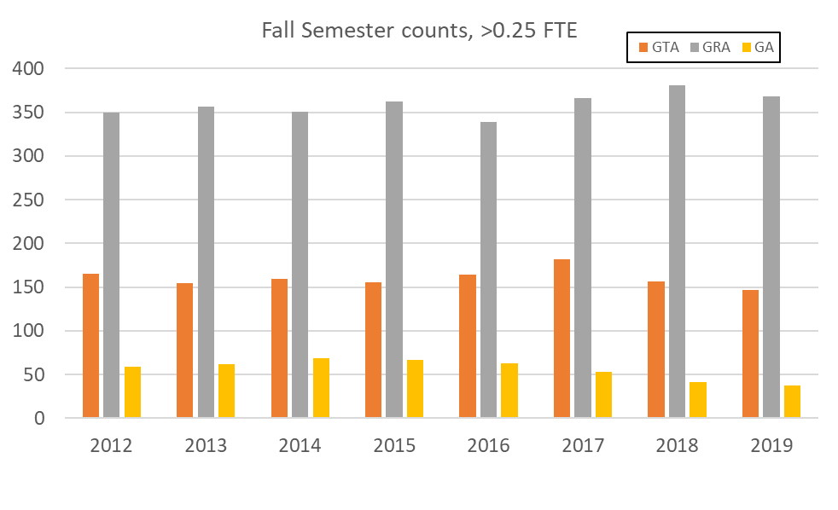
Seemingly flat, total is 553-601

Slide 57
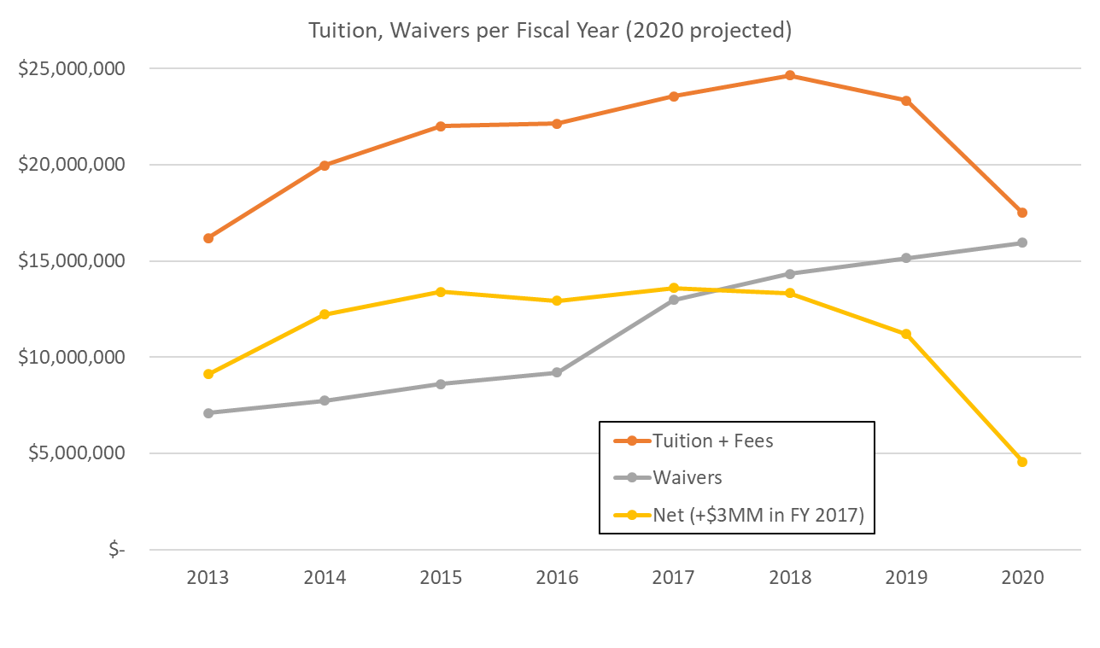
Waiver jump
$3.76 MM
$760k over state $
Down
$8.6 MM

Slide 58
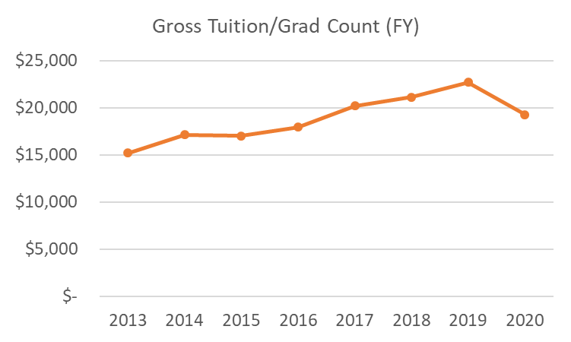
This year lower revenue per student
Gross: waivers not included
Grad tuition rate up 3-4%
PhD down 42, MS down 61, Certificate down 16, but data shown is per student
Mix could be more residential (form 16% to 47% would explain)
Lowered credit hours per student?

Slide 59
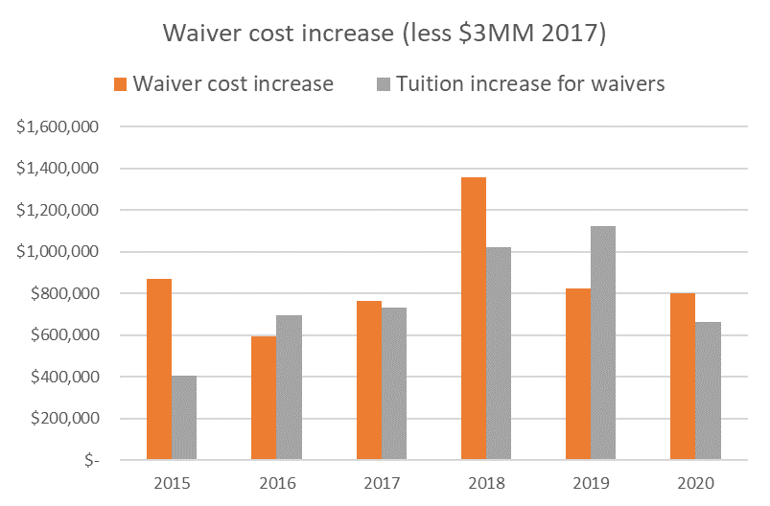

Slide 60
Observations
Decrease of 441 MS, FS 2014 to FS 2019
Increase of 75 PhD, FS 2014 to FS 2019
Last two years, gross tuition $ down (student counts down), waivers up
Last semester gross grad tuition $1 MM less than FS 2018
Yes, waivers cost more, but
Number of waivers little changed if GRA, GTA, and GA counts little changed
Total waiver cost increase similar to total tuition increase for students on waiver
When 6/9 implemented
Waivers increased $3.76 MM;
Less state-provided $3 MM (FY 2013) and increase in tuition = $333k
Continuing annual cost

Slide 61
Agenda
VI. Administrative Reports
A. Chancellor’s Report
M. Dehghani

Slide 68
Agenda
New Business

Slide 69
Agenda
VIII. Adjourn
69

